Slide 1

Air Quality on
Quality of Life
Data analysis conducted by:
Akbar Fadillah & Andrew McLaughlin & Benoit Chamot & Valery Ravera Cardona
Notes:
Andrew will share his screen, Benny presents this
—------------------
Welcome to Group 1’s presentation for our first data analytics project.

Slide 2
What is the impact of air quality on quality of life?
Notes:
Benny
In this study, we consider that a global environmental health organization wants to understand the relationship between air quality and quality of life across different countries. In the next slides we will define what we mean by air quality and quality of life before presenting our questions and moving on to our analysis.

Slide 3
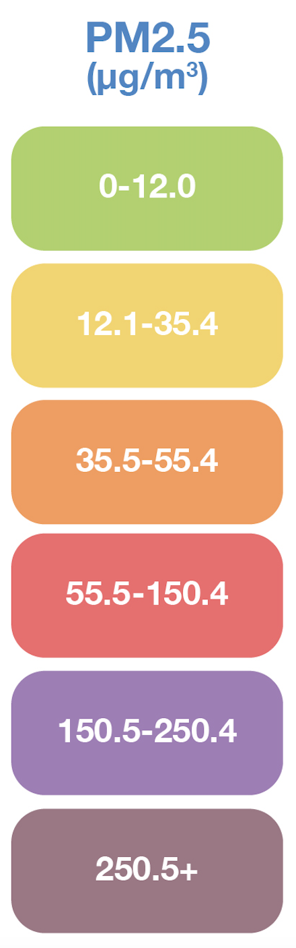

What we mean by “Air Quality”
PM2.5 = Particle Matter smaller than 2.5 micrometers
Low concentration = Good air quality
One of many pollutant…
… and one with the most data available
Comes from:
Vehicle emissions
Industry
Woodworking and burning
Gas stoves
Tobacco smoke
We will refer to Pollution Level from now on
High PM2.5 number = High pollution
Good
Moderate
Unhealthy for
Sensitive Groups
Unhealthy
Very Unhealthy
Hazardous
Notes:
Benny:
We equate air quality to the concentration of PM 2.5 in the air, in terms of mass per unit of volume. PM 2.5 simply means “Particle Matter smaller than 2.5 micrometers”.
When the concentration is low, the air quality is good and when the concentration of PM 2.5 is high, the air quality is poor.
PM 2.5 is only one type of pollutant. We selected it as our main metric for air quality for two reasons:
First, there is a large amount of data available for different countries and it is very regularly measured.
The second reason is more relevant to our specific study: while PM 2.5 is not as problematic as CO2 or methane when it comes to climate change, it may have a more immediate impact on people’s health, especially when it comes to respiratory diseases.
PM 2.5 comes from various sources such as vehicle emissions, industry, gas stoves and tobacco smoke.
From now on, to keep things simple, we will simply refer to PM 2.5 concentration as “Pollution Level”. In our results, when you see a high number for pollution level, it simply means that the concentration of PM 2.5 is high and therefore the air quality is poor. Likewise: a low pollution level means a low concentration of PM 2.5 and therefore better air quality.
I will now hand over to Val to discuss our key questions and how we define quality of life.

Slide 4
Key Questions
Asthma
Life Expectancy
Happiness Score
Does a country’s air quality have an impact on the asthma prevalence?
Does a country’s air quality have an impact on the hospital admission due to asthma?
Is there a significant correlation between air quality and life expectancy in different countries?
If so, how strong is this correlation?
Does air quality have an impact on the happiness score of a country?
Is there a clear difference in air quality between the top and bottom ranked countries?
Notes:
Val:
Thank you Benny.
We will be defining quality of life in three metrics:
Asthma, Life Expectancy, and Happiness Score.
Diving deeper into our Asthma metric, we are defining quality of life in terms of physical health, in particular respiratory.
Key Questions we will be looking at:
Does a country’s air quality have an impact on the asthma prevalence?
Does it also have an impact on the hospital admission due to asthma?
As a second metric for quality of life, we considered life expectancy as older people may be more affected by poor air quality.
Key Questions include:
Is there a significant correlation between air quality and life expectancy in different countries?
If so, how strong is this correlation?
Finally, in our last metric, we looked at quality of life in terms of mental health, represented by the Happiness Index.
We'll be diving deeper answer the questions:
Does air quality have an impact on the happiness score of a country?
Is there a clear difference in air quality between the top and bottom ranked countries?

Slide 5

Asthma
Prevalence & Hospital
Admissions
Notes:
Val: In these next slides we will be looking at the first metric, being Asthma. Specifically the impact on asthma prevalence and hospital admissions.

Slide 6
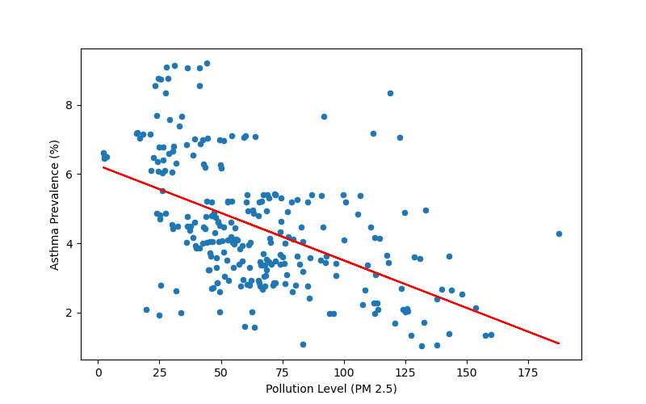
Air Quality vs Asthma Prevalence
There is a negative correlation
Factors that may affect this include:
Air quality regulations
Healthcare and reporting
Socio-economic
Pearson’s coefficient of -0.51 (moderately negative)
Implying as pollution increases the asthma prevalence decreases
Notes:
We conducted an analysis on the years 2015 - 2019.
With the data plotted, we can see here there is a negative correlation between the two.
The Pearson coefficient is an R-value of -0.51 which indicates a **moderate negative correlation**, suggesting that as pollution increases the asthma prevalence decreases.
This result is out of line of what we expected of the data - as it's saying countries with better air quality, have more asthma prevalence.
- Factors that may affect this could be:
- varying air quality regulations, differences in healthcare and reporting, socioeconomic factors, and regional variations.
- Example: Countries with better healthcare infrastructure and higher awareness about asthma might have more accurate and comprehensive reporting of asthma cases, resulting in higher cases even if the air quality is better.
I will now hand it over to Benny to take you through hospital admissions.

Slide 7
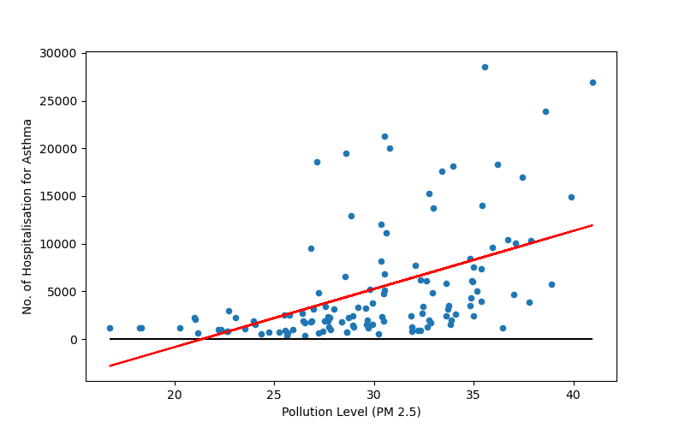
Air Quality vs Hospital Admissions
due to Asthma (USA, 2015-2021)
There is a positive correlation between the PM 2.5 concentration and the number of hospital admission
Pearson’s coefficient of 0.493 (moderate correlation)
Notes:
Benny:
To further understand the link between pollution levels and asthma, we looked at the number of hospital admissions caused by asthmatic symptoms. We focused on the US only to restrict the geographical area and because we could find more complete datasets per state and per year.
In this case, we observe a moderate positive correlation which is more in line with our expectations.
From this part of the analysis, we can conclude that while asthma prevalence decreases as pollution levels increase, the hospital admissions chart shows that when it comes to complications due to asthma, pollution levels may have a negative impact on people’s physical health and therefore quality of life.

Slide 8

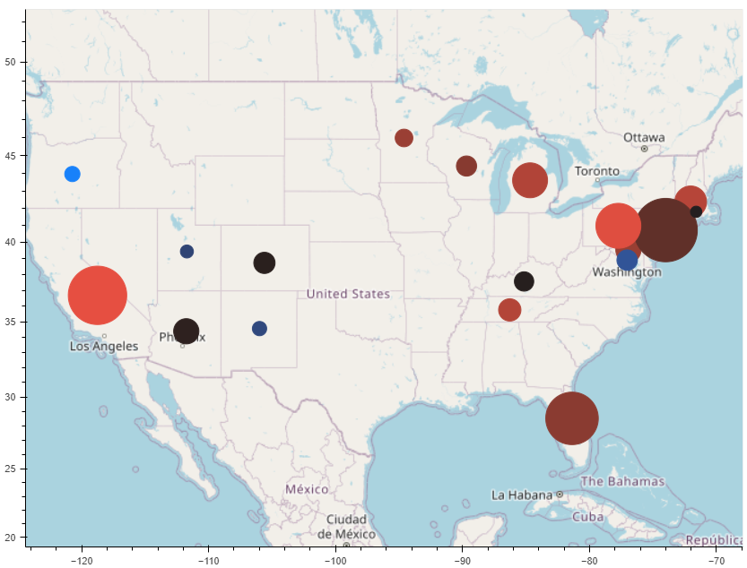
Air Quality vs Hospital Admissions due to Asthma (USA, 2018 only)
High
Pollution Level (PM 2.5)
Low
Size of Dots = Number of Hospitalisations
Larger cities have poorer air quality and the largest number of hospitalisations (e.g. California, New York and Florida)
Smaller cities have better air quality and fewer hospitalisations (e.g. Oregon)
Notes:
Benny:
This map shows the same type of information as the scatter plot on the previous slide but in a different manner. The states available in the datasets are shown with colored dots. The color indicates the pollution level: red for high pollution and blue for low pollution. The size of the dots represents the number of hospital admissions for issues related to asthma.
We can observe that states with larger cities, with more people, such as California on the West Coast, Florida in the South East and New York on the East Coast present higher level of pollution. They also show a higher number of hospitalisations caused by the number of people but possibly also by the poorer air quality.
On the other hand, states with smaller cities such as Oregon in the North West, present the opposite trend: air quality is good and number of hospitalisations is low.
I will now hand over to Akbar to discuss another measure of quality of life: that is life expectancy.

Slide 9

Life Expectancy
Notes:
Defining or Explaining Life Expectancy
Akbar

Slide 10
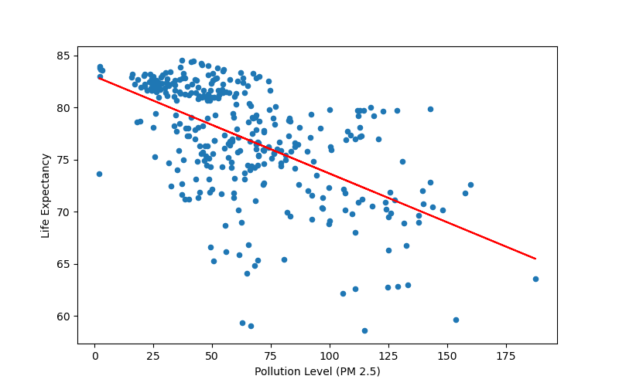
Air Quality vs Life Expectancy
Negative correlation between air quality (PM 2.5) and Life Expectancy
R-value: -0.58
Higher Pollution Level = lower Life Expectancy
Notes:
Air Quality vs Life Expectancy graphs
Akbar

Slide 11
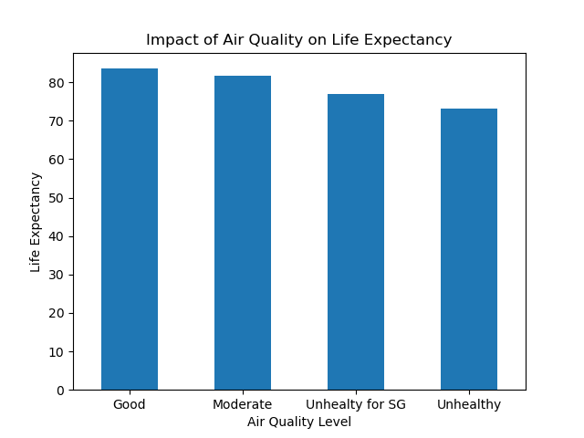
Air Quality vs Life Expectancy
Good and Moderate Air Quality Index have higher Life Expectancy
Unhealthy Air Quality Level have lower Life Expectancy
Notes:
Air Quality vs Life Expectancy graphs
Akbar

Slide 12

Happiness Index
Notes:
For our next question, we looked a Country’s Happiness Score compared to air quality.
Andrew

Slide 13
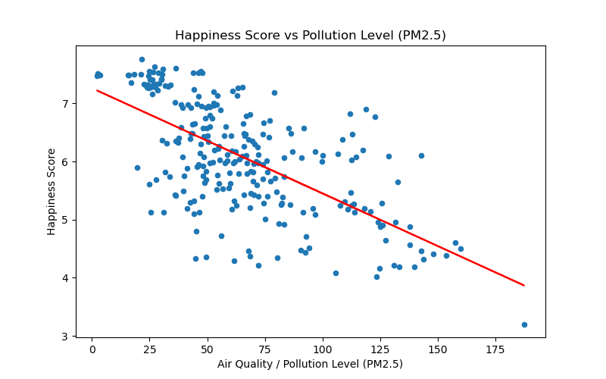
Air Quality vs Happiness Score
Happiness Scores for 72 countries across 5 years
Moderate Negative Correlation found (R Value: -0.64)
As pollution increases, Happiness Score declines
Notes:
For this first graph we used all our available Happiness Scores data to plot pollution levels vs Scores.
Across the x-axis we have pollution levels, and on the y-axis we have a countries final Happiness Score. A higher score being a better result.
When we graphed the regression, we found a moderate negative correlation with an R Value of -0.64.
So we can see a relationship between pollution increasing, and a Country’s Happiness Score decreasing
Andrew

Slide 14
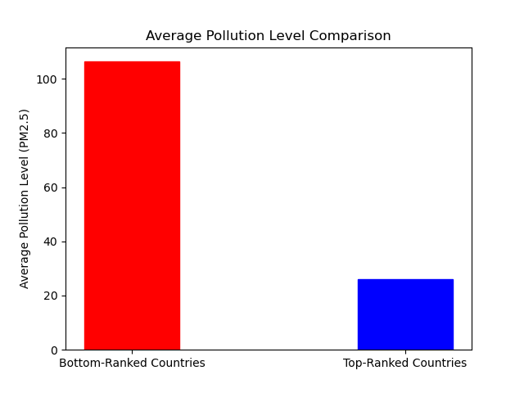
Air Quality vs Happiness Index
Comparing average pollution (PM2.5) across top-ranked and bottom-ranked countries
Visible distinction between the two ends of the Happiness Index
Top-ranked countries = low average pollution
Bottom-ranked countries= high average pollution
Notes:
Top-ranked countries = any country that got a ranking in the top 10 (42 countries)
Bottom-Ranked countries ranked greater than 91 (42 countries)
We then took the average pollution level for each of these groups for this graph.
Top-ranked countries average pollution falls into the ‘Moderate’ air quality category.
Bottom-ranked countries average pollution actually falls into the ‘Unhealthy’ category.
Andrew

Slide 15
Conclusions
Asthma Prevalence: Driven by other factors (negative correlation found)
Asthma Hospitalisations: Positively correlated with air quality
Life Expectancy: longer life expectancy in good air quality countries
Happiness: High scoring countries on the Happiness Index had lower pollution levels.
There is generally a positive impact on quality of life due to good air quality
Notes:
So in conclusion to our key questions, we initially found that air quality does not directly impact Asthma Prevalence in a country, and actually found there to be a negative correlation between the two. This led us to analysing Asthma Hospitalisations in specific areas which resulted in a moderate positive correlation. Air pollution increases, so does hospitalisations.
Life Expectancy had a moderate negative correlation. Increase in pollution showing a decrease in life expectancy.
A country’s Happiness Score compared to air quality also showed a moderate negative correlation. Air pollution increases, Happiness Score decreases.
So despite air quality being just one metric, and our group recognising further analyses would be needed for more conclusive results, we did find that generally speaking good air quality does seem to improve quality of life in the areas we explored.
Thank you. This concludes our presentation.

Slide 16




Thank you from the Team
Akbar Fadillah
Andrew McLaughlin
Benoit Chamot
Valery Ravera

